Slide 1
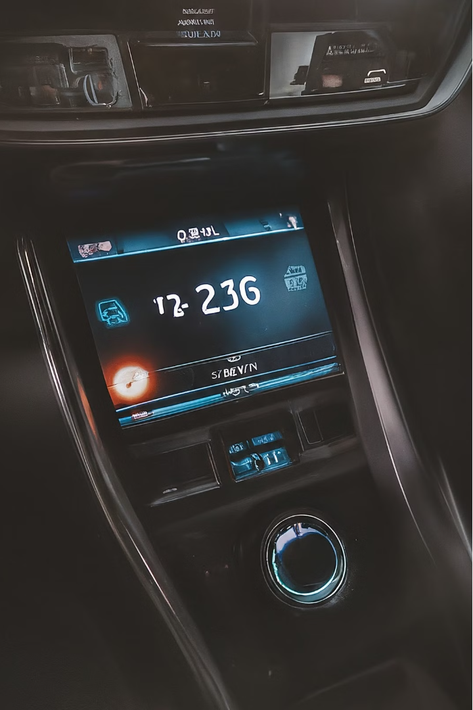


Anti-Sleep Alarm for Drivers
An IoT-based system to detect driver drowsiness and provide timely alerts to prevent accidents.

Slide 2
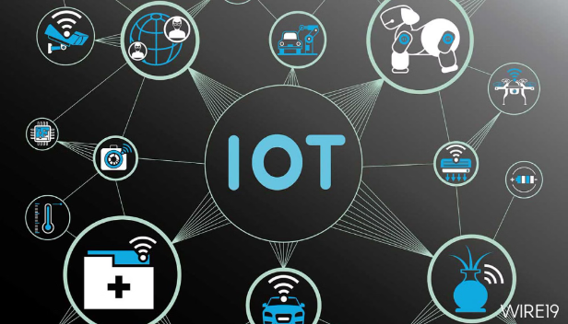
Contents:
Aim
Introduction
Requirements
Methodology
Result
Conclusion
Future Scope

Slide 3
Anti-Sleep Alarm for drivers
Aim: The goal of this project is to create an IOT-based alarm system that helps drivers stay awake and alert by detecting drowsiness and providing timely warnings.
Introduction: Drowsy driving is a major cause of accidents. Traditional methods to keep drivers awake aren't always effective. This project uses modern IOT technology to monitor the driver's alertness and provide alerts to prevent accidents.

Slide 4
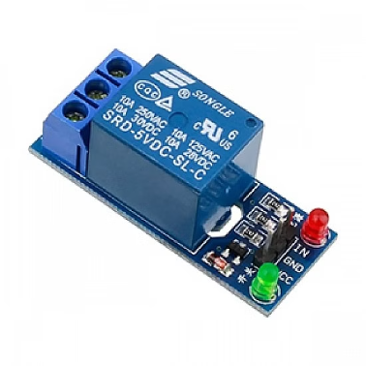
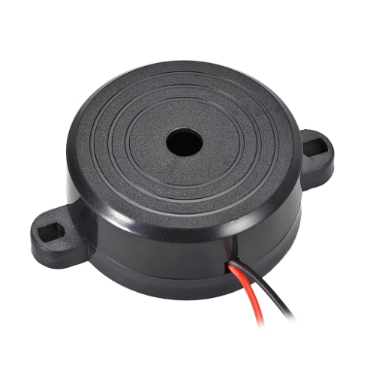
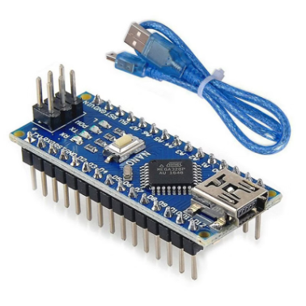
Requirements:
Hardware Components:
Relay
Piezo Buzzer
Arduino Nano
Controls buzzer and alert system.
Emits loud sound to wake driver.
Brain of the system, processes data.

Slide 5

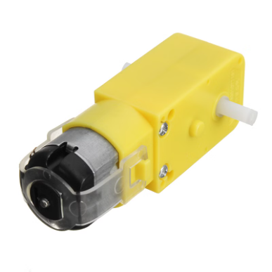
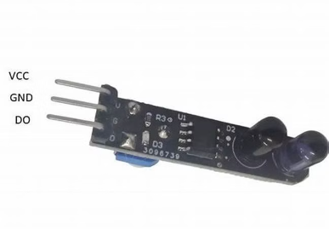
More Hardware
9V Battery
Gear Motor
Eye Blink Sensor
Powers the entire system.
Vibrates steering wheel to alert driver.
Monitors eye movements for drowsiness.

Slide 6
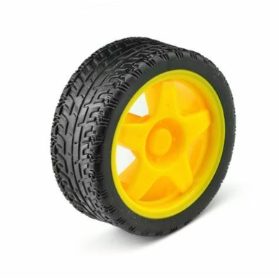
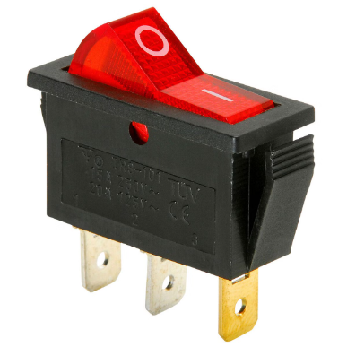
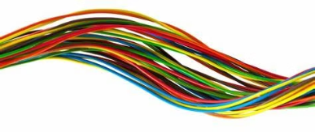
More Hardware
Wheel
SPST Switch
Connecting Wires
Rotating part of the vehicle.
Turns the system on and off manually.
Connect all components.

Slide 7




Software
1
Arduino IDE
2
OpenCV
3
Data Processing
Programming environment for the system.
Library for image processing.
Analyze sensor data for drowsiness.

Slide 8
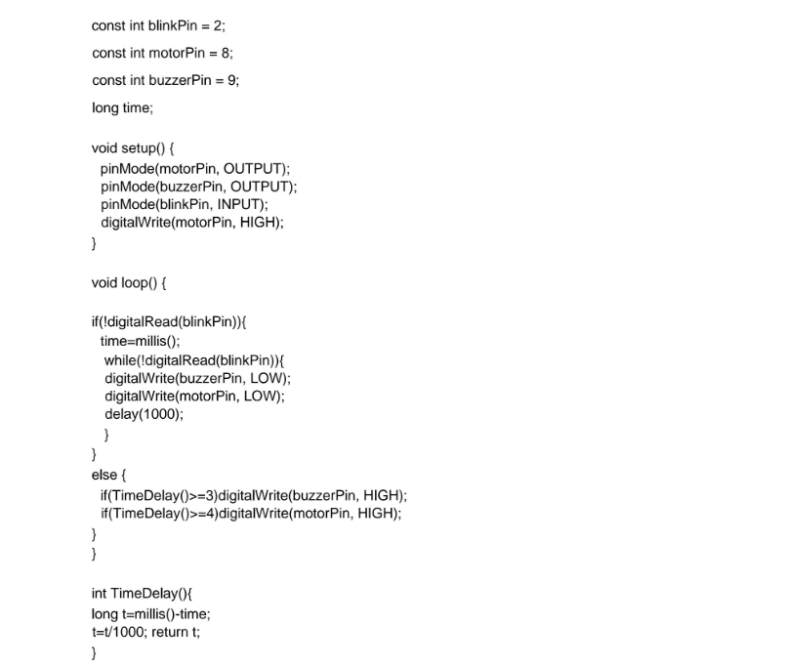
//Program code for Anti sleep alarm Detector for drivers

Slide 9

Methodology
Sensor Setup
Alert System
Connect eye blink sensor to microcontroller.
Trigger buzzer when drowsiness detected.
1
2
3
Data Collection
Collect real-time data on eye closure.

Slide 10
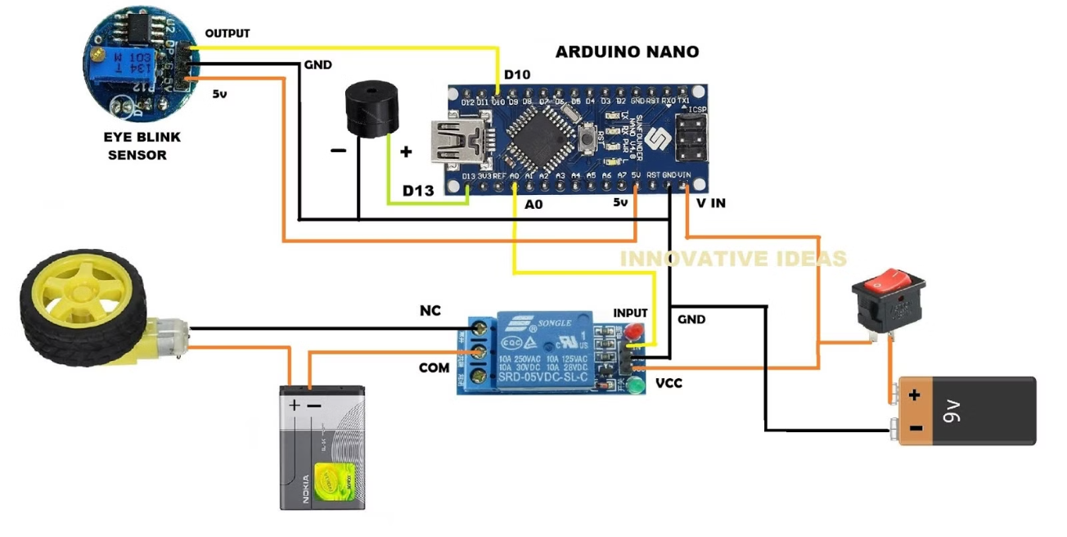
Circuit Diagram:

Slide 11
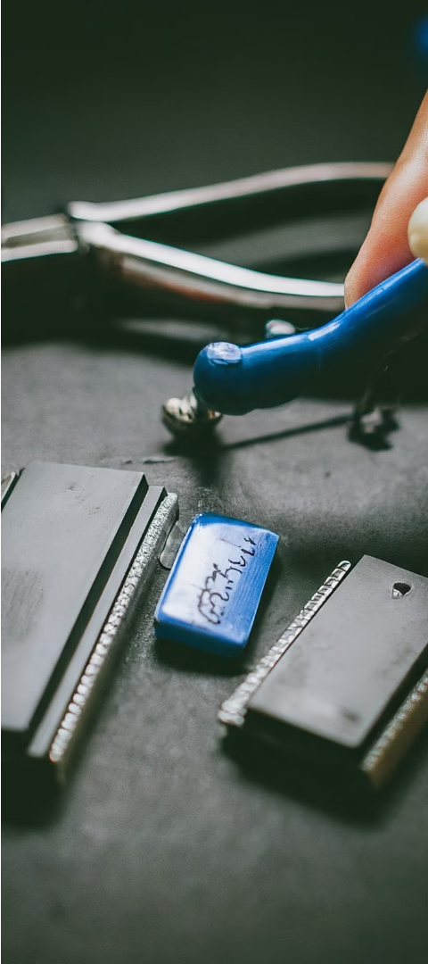
Implementation
1
Hardware Assembly
Connect all components to microcontroller.
2
Software Development
Write code to detect drowsiness.
3
Real-World Testing
Install and test in vehicle conditions.

Slide 12
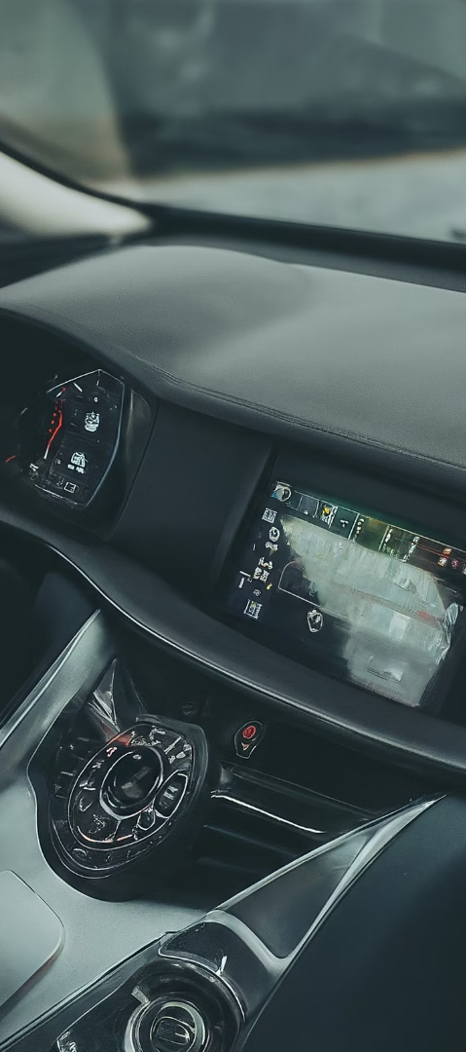
Results
Drowsiness Detection
Alert System
Accurately detect when driver is drowsy.
Trigger buzzer and stop vehicle wheels.

Slide 13


Conclusion
Accident Prevention
IoT-based Solution
Reduce risk of accidents due to drowsy driving.
Leverages sensors and microcontroller for real-time monitoring.

Slide 14
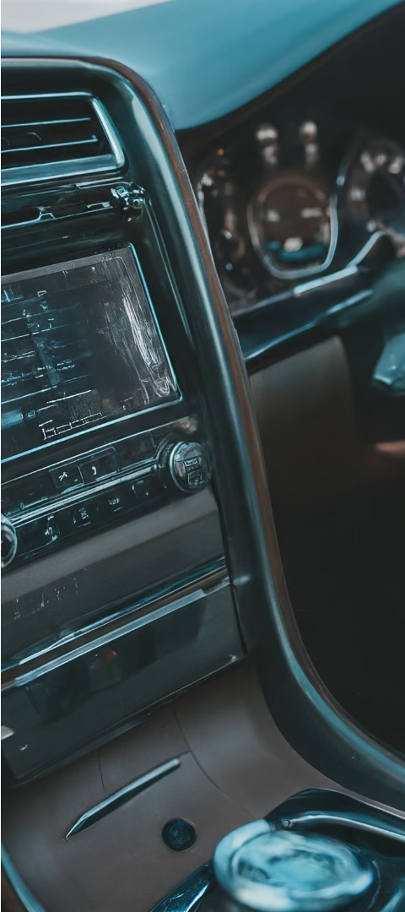



Future Scope
Improved Algorithms
Use advanced ML for better drowsiness detection.
Vehicle Integration
Connect to vehicle controls to slow down car.
Market Deployment
Work with automakers to make it a standard safety feature.

Slide 15
Thank You !
Submitted by:
Nikhil Ramteke
Roshan Kumar Paikra
Deepak Kumar Lakra
Mandeya Ram Kashyap
Guided by:
Prof. Himanshu Mokashe

